Slide 1
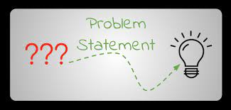
Problem Statement
The objective of our project is to build a system to control the blinds in the TLA in Coover on Iowa State Campus for anyone who uses the space in order to improve convenience and time-usage for the user of the blinds. This system will be accessible during the day and night and easy to use. We will use a motor and control system connected to a designed application to solve this problem.
Notes:
Caleb - 30 seconds = FAST
notes:
An automated and scalable system for opening and closing the blinds in the TLA.

Slide 2
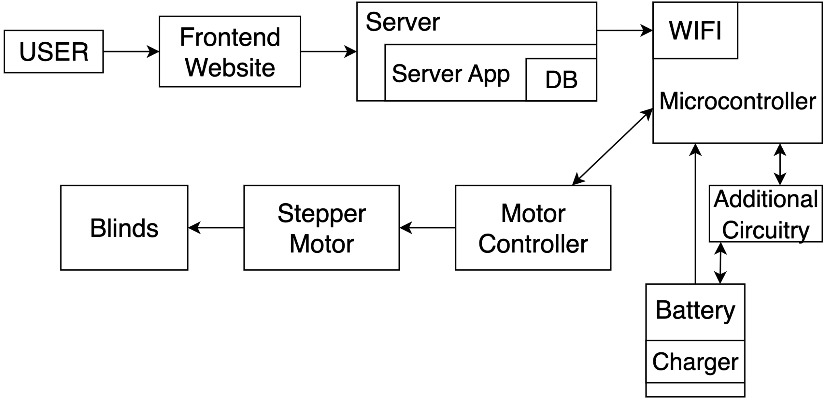
Conceptual Sketch
From
User
to
Blinds
Blinds: End Result
Motor Direction | blind motion
------------------------------------------------
Clockwise | down
Counter-Clockwise | up
Notes:
Caleb - 30 seconds = FAST
Notes: blinds go up or down / perspective is from looking up at ceiling. From user to blinds the concept. User able to control blinds (openness) mobally.
https://app.diagrams.net/#G1GQGxYMCOOFrl7FtDrPRkV6bSt9LrZzvS

Slide 3
Functional Requirements
Web Application
When a user logs in to the application, it shall use NextAuth to authenticate them over Google
The application shall be accessible over both standard computers and mobile devices
When a user logs on and is authenticated by the admins list they shall be able moderate the blinds system
The web application shall be able to communicate with the server over HTTPS
The application shall display the current states of the blinds given server information
Hardware
The device shall be able to receive udp requests from the server
When a packet is received by the device it shall modify its current state to the provided position
The device shall have precision control such that the blinds attached to it will not break
When the Power on the device reaches a low state the device shall save its current state and disable wireless communication
Notes:
DANIEL - 1 min
Okta is what we use to log into canvas
Accessibility because it allows people who couldn’t otherwise reach the blinds to be able to do so.

Slide 4
Nonfunctional Requirements
Web Application
Easily Navigable and Intuitive to Use
Maintainable by Admins
Accessibility - Include aria-labels for people with visual impairment
Hardware
Reduce unnecessary size
Maintainable by Ease of Access to Components in Box
Scalable and Reproducible
Unobstructive Look in TLA
Notes:
ANDREW - update
Application
Navigable / Intuitive to use
Software can only be used by Iowa State students
Software is extensible
Hardware- Hieu
Allow for extra wall space
Will be able to mass produce

Slide 5
Technical Constraints/Considerations
Costs
Given budget of $500 for 2 units
Scalability
How can this unit be mass produced?
How can we repeat the process cheaply?
Space
How can we minimize hardware size?
Access
How do we ensure only ISU students and faculty can use the web app?
How do we ensure only people in TLA can use the web app?
Notes:
DANIEL
Danny
Our primary concerns were about how we can make it repeatable for ISU, and constraints about money

Slide 6
Potential Risk and Mitigation
Hardware Risk
Device Breaks
User Error
Component Failure
Positional Failure
Device loses power
Blinds breakage
Physical Danger
Electrical shock if wiring left exposed
Pinching if engaging with motor
Software Risk
Software Communication Errors
Notes:
Hieu -30 sec
Here we have some of the potential risk and mitigation, but a couple high risk that we thought of is software delay, with the 70 percent and part delay when ordering is 50 percent

Slide 7
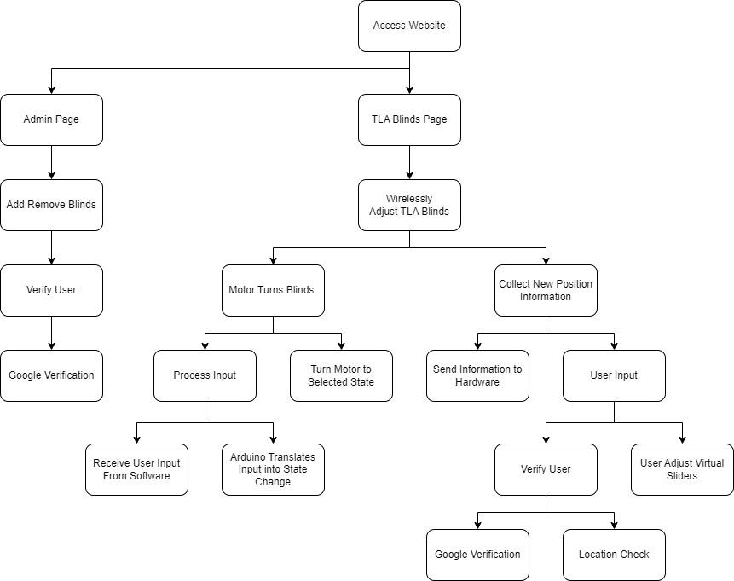
Functional
Decomposition
Notes:
Can we make the font size bigger?? Could be hard to see - Caleb
Adjust, add Admin, top block that splits into admin and into systems
Okta -> Google
Motor changes degrees -> changes states
Logan

Slide 8
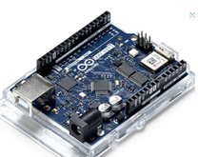
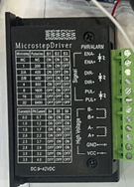
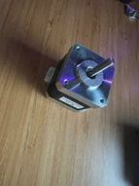
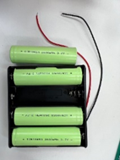
Hardware Technology Platform
Arduino
Uno Wifi R2
u-blox NINA-W102(wifi)
eeprom
Speed Controller
Microstep Driver TB6600
Motor
Creality 42-40 stepper motor
Battery 18650 and holder
For long term durability (up to 20 years)
Easier to change battery
Notes:
HIEU
Updating by Hieu (can update more if you want to change)

Slide 9
Resource/Cost Estimate
Component | Cost
Arduino Uno Wifi R2 | $53.80
Stepper Motor Driver | $7.98
Stepper Motor | $10.99
Clear industrial Box | $32.20
Connection Tubing | $0.35 per foot
18650 Battery | $5/battery (x4)
We have found similar Ideas on the market
Most use a controller per unit
Are not easily fixed
Most are in the $150-175 range for motor and then the cost for the blinds
Require complete overhaul of current resources
Select Blinds Shades- $125.32
If you were to buy in bulk
3 - 74.83/Final Device
Device Total Cost: 125.32
Notes:
jacob

Slide 10
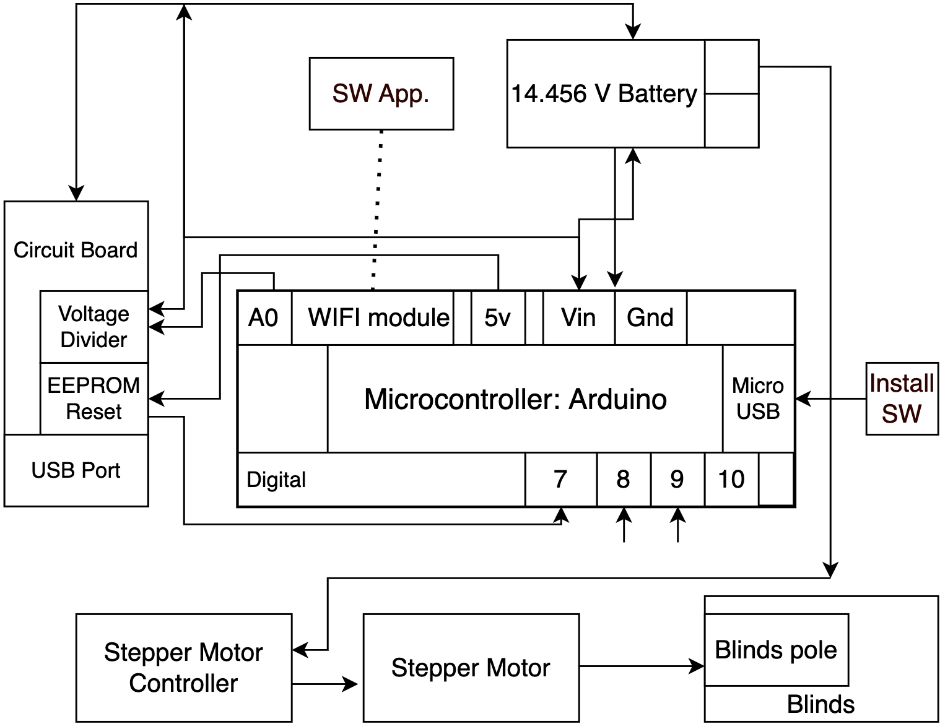
HW
Detailed
Design
Motor | Blind
Direction | Motion
—-----------------------
CW | down
C-CW | up
Notes:
EEPROM stands for electrically erasable programmable read-only memory
USB: Universal Serial Bus
WiFi: Wireless Fidelity
https://app.diagrams.net/#G1jnDjXyA3SfWAsiiMAWR9gMF6gtKGR5mY // Motor controller regulates the current, voltage, and power in a better way, more specific to the needs of the motor than the arduino would.

Slide 11
Design - Hardware
Arduino using its u-blox NINA-W102 receives UDP packets to sends controls signals
Monitors battery on analog. When on low logs state in eeprom and disables wifi.
Power
18650 battery with battery series connection holder
Power Buck Module 6V32V12V24V to Q3.0 fast charging single USB
Assembly
Stepper Motor Driver, Stepper Motor
Arduino UNO wifi
Industrial Box
Plexi-plate
Bolts with spacers
Wiring Connection
Voltage divider between battery and arduino
EEPROM (electrically erasable programmable read-only memory) button reset
Stepper motor controller to arduino
Stepper motor controller to stepper motor
Battery to motor controller

Slide 12
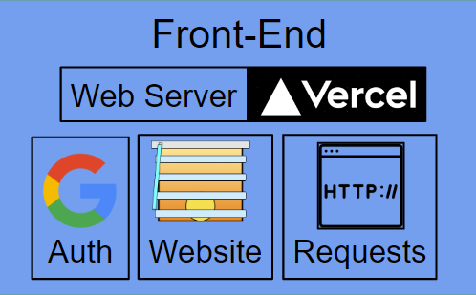
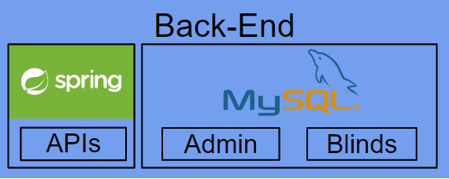
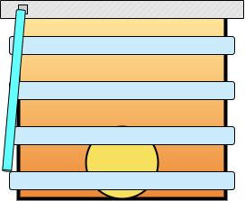
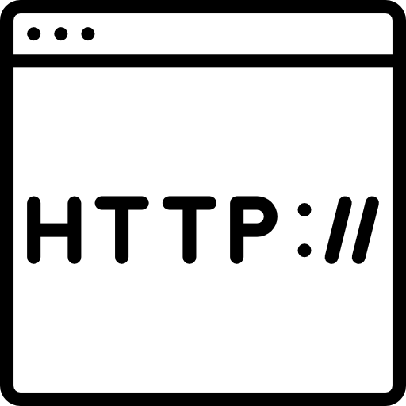
SW Detail Design
Back-End
APIs
Admin
Blinds
Authenticated via Google
User
Front-End
HTTP Requests including:
GET Requests (blinds, adminList)
POST Requests (addAdmin)
PUT Requests (moveBlinds)
etc…
Web Server
Arduino
Auth
Website
Requests
Movement Command issued via UDP
Notes:
Andrew

Slide 13
SW Technology Platforms
Back-End
Spring Boot
Maven
REST API
MySQL
Microcontroller
Arduino Libraries
Front-End
React.js
Next.js / Vercel
Chakra UI
Next-Auth + Google
Notes:
Andrew + Update (redux)
Web development // HTML like bricks of a web page /// CSS is painting / JAVA - makes it interactive React.js is flavor of Java ///// Next.js goes on top of React.js, the webpage is already uploaded.
Chakra UI - buttons
Next-Auth + Okta - users
My SQL is DB // Rest API communicates between Backend and server and maven Spring Boot are back end.

Slide 14
Design - Server
Given Linux Ubuntu server vm
Device ips are from ISU network, Server acts to connect Web application to device
Software installed onto the server
Installed mysql, java 17 , maven
Runs spring boot server over https
Spring boot application uses:
Acts as a devices address book and log for frontend
Acts as a request queue for hardware
Notes:
Jacob

Slide 15
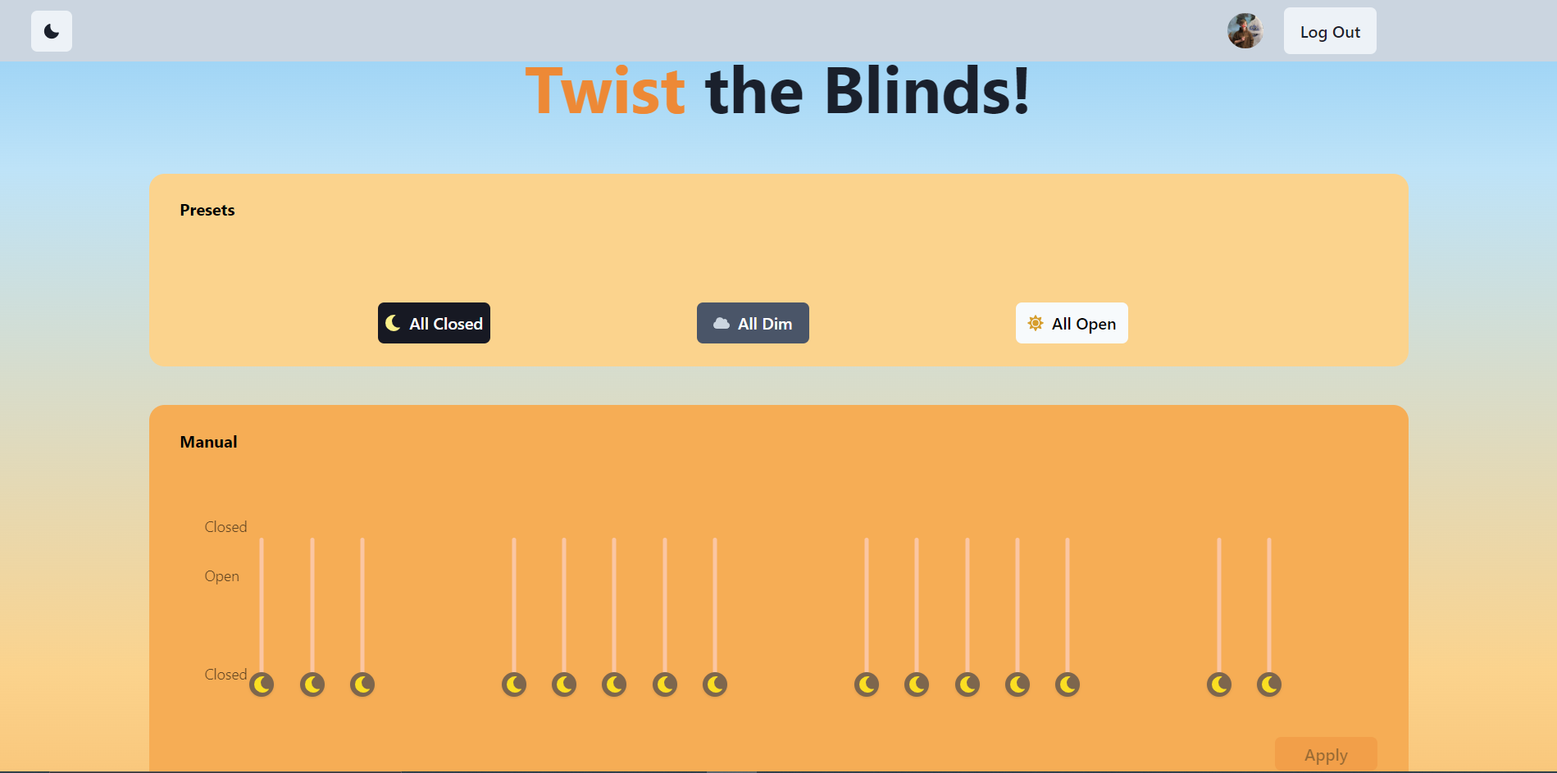
Design - Web Application
React JavaScript Frontend
Chakra-UI as a component library
Landing Page and Subsequent Pages
User log on before loading up other pages
Room Pages
Pages for editing the blinds specific to a room, such as the TLA
Admin Page
Authenticated users can access admin page where they can add/remove blind systems

Slide 16
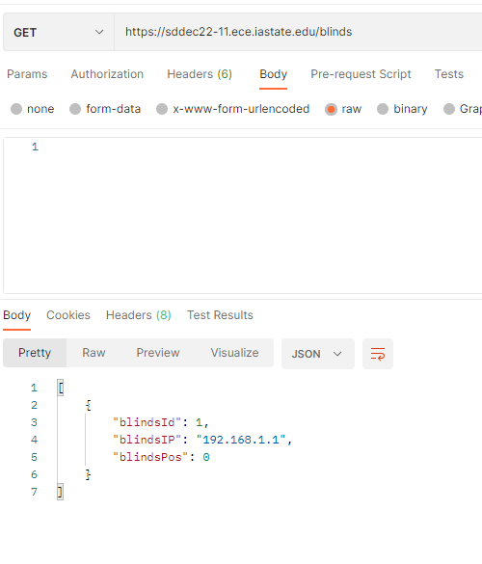
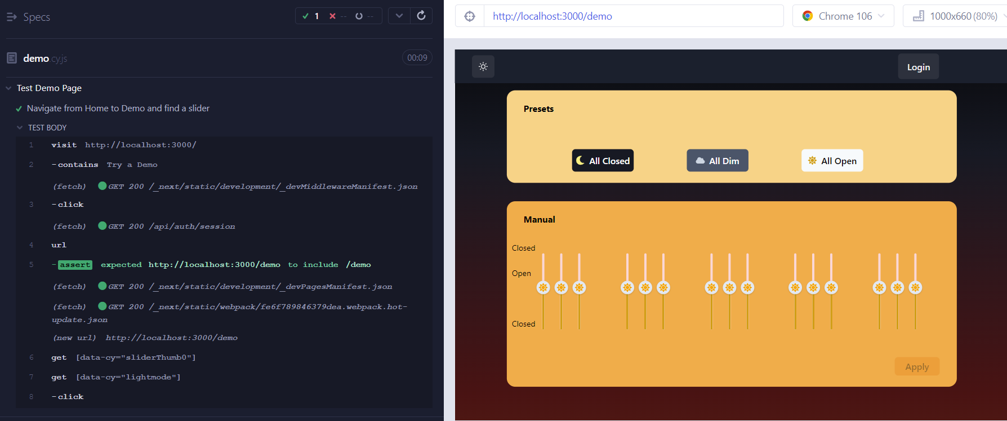
Testing
Made use of a postman to test Rest APIs
Arduino serial monitor for packet reception
Frontend testing done with Cypress.
Tests frontend buttons and operations
Tests are written and run to completion for all pages

Slide 17
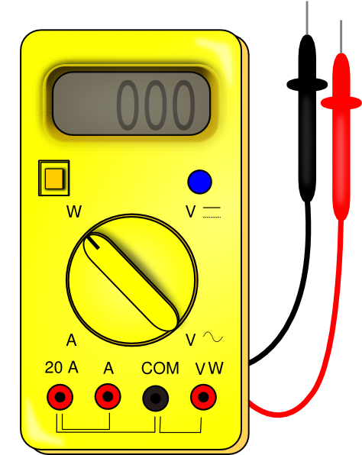
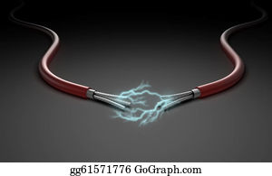
Hardware Testing
Tested electrical values between components
Placement of parts was tested for size
System was tested connected in tandem
Physical interaction tests done with blinds
Notes:
LOGAN

Slide 18
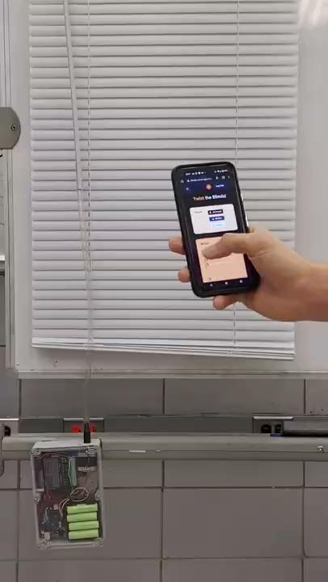
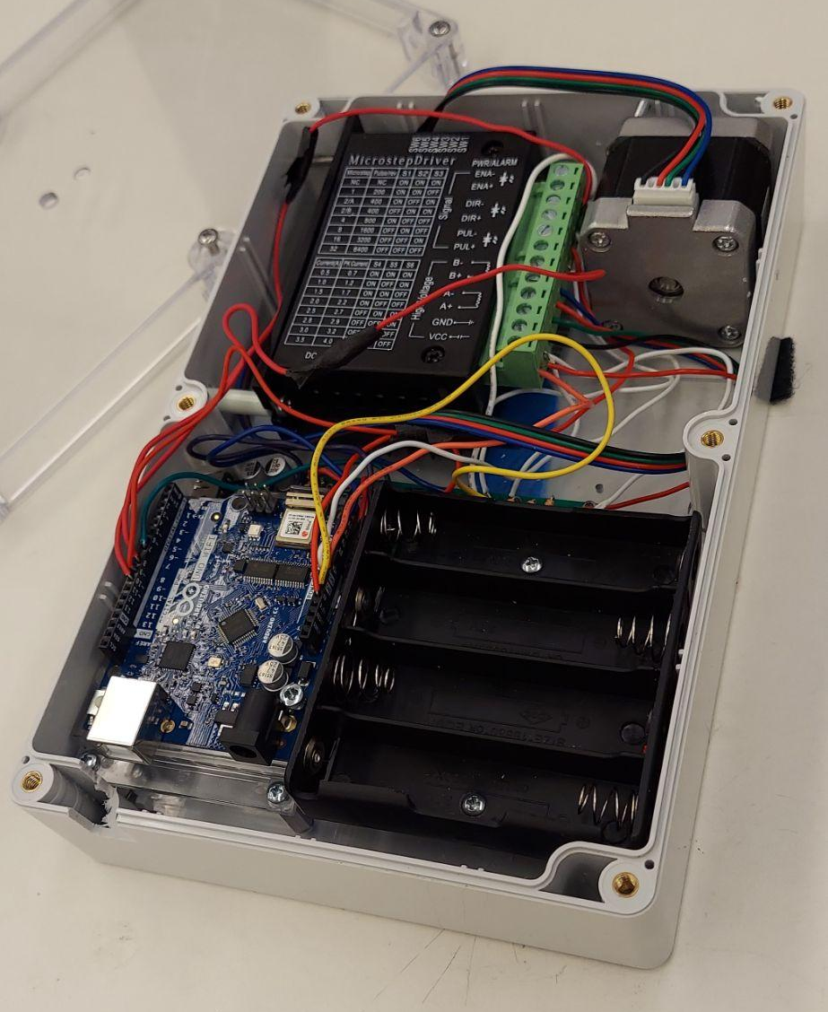
Final
Product
Notes:
SW - Andrew HW
HW - Hieu - for the hardware side, component wise in prototype we have the batter, board, motor and the blind.

Slide 19
Challenges
Team:
As team we had a hard time maintaining our planned schedule and working with in the time frames we gave each other
Lack of good minutes had us often forgetting goals and deadlines.
The team often struggled to have everyone at scheduled meetings
Software:
Issue with front to back end communication. Learn about CORS error between JS and Spring Boot.
Server issue with connecting to database
Testing the frontend
Hardware:
Accounting for the unexpected (expect problems to arrive)
Finding a versatile connection from motor to any blind rod
Poor understanding of documentation leads to breaking several components
Notes:
Hardware - Logan
Software - Andrew

Slide 20
Lessons Learned
Team
Planned ahead, keep track of meetings, hold each other accountable.
Software
Setting Up Website
Many Javascript Add Ons
Location Services
Cypress
Hardware:
Be careful with the Arduino
Don’t plug power into reset
Take out batteries (remove power) when adjusting component placement
It better to buy a part for something than soldering it together.
Don't overbuy parts until it is clear they will work (use of majority of budget)
“Nothing comes as easy as you expect the first time you do it” - Use of time quote
“Measure twice, cut once”
Notes:
Hardware - Jacob
Software - Danny

Slide 21
Senior Design
Team 11
Final Presentation
Andrew, Caleb, Danny, Hieu, Jacob, and Logan
Advisor: Lee Harker
Client: ECPE department
Notes:
Caleb - Welcome / everyone introduce yourself - 15 seconds = FAST

